Slide 1


DATA | MODULE 2
Hypothesis Testifig
Week 5

Slide 2
Table of Contents
Central Limit Theorem
Definition of Hypothesis
Steps in Hypothesis Testing
One Sample T-test
Two Sample T-test
Paired Sample T-test
ANOVA

Slide 3

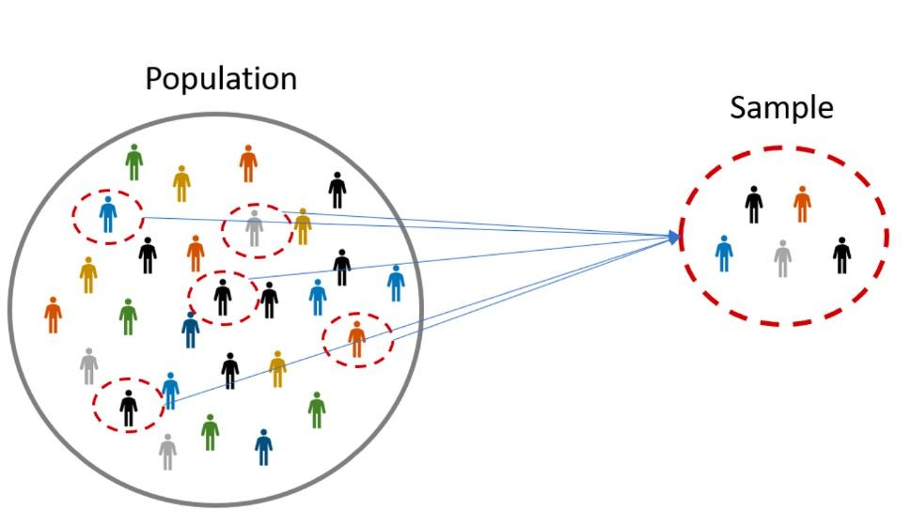



Central Limit Theorem
Imagine that you take samples from a population of people’s heights, and for each sample you calculate their mean.

Slide 4
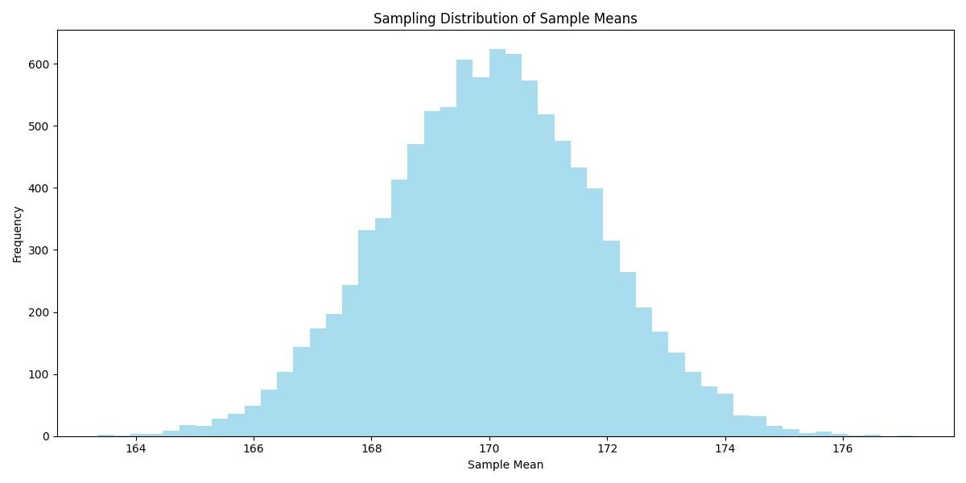
Central Limit Theorem
Now, if we plot all sample means, we get a familiar shape, a normal distribution. In other words, the distribution of the means of the sampling distribution tends towards a normal distribution.

Slide 5
Central Limit Theorem
The sampling distribution will consistently tend toward a normal distribution, having its own mean and standard deviation. An essential takeaway is that the mean of the sampling distribution equals the population mean. This is happens regardless of the shape of the population distribution.

Slide 6
Central Limit Theorem
The Central Limit Theorem (CLT) states that, irrespective of the shape of the underlying population, the sampling distribution of the mean will approximate a normal distribution as the sample size grows larger (n > 30), assuming all samples are identical in size and randomly sampled.
Large Sample Size & Individual Data Points: Even with a large sample, the distribution of individual data points could still be non-normal. For instance, a dataset with millions of data points could exhibit significant skewness or extreme kurtosis.
Large Sample Size & Averages of Samples: If you are taking multiple samples from a population and calculating their averages, the distribution of those averages tends to be normal due to the CLT, even if the underlying population is not normal.
Practical Implications: While the CLT is powerful, it's important to remember that many statistical tests and methods assume that the individual data points (not their means) follow a normal distribution. Therefore, having a large dataset doesn't allow you to bypass these assumptions.

Slide 7
Hypothesis Testing

Slide 8
Hypothesis Testing
What if we assume that being inside the lines would be good enough to consider something “valid”?

Slide 9


Hypothesis Testing
The first step in hypothesis testing is formulating a hypothesis, which is a premise or claim that we want to test about a population parameter. The objective of a hypothesis test is to decide, based on a sample from the population, which of two complementary hypotheses is true:
Null Hypothesis
- Currently “accepted” value for a parameter.
Alternative Hypothesis - The alternative hypothesis is a statement asserting an alternative condition or outcome compared to the null hypothesis.

Slide 10

Hypothesis Testing
In a hypothesis testing problem, after observing the sample the experimenter must decide either to accept s as true or to reject .
Let’s see the following example:
If 𝜇 denotes a population parameter, let’s say the change in a patient’s blood pressure after taking a drug, we write:
= 0 versus ≠ 0
The null hypothesis states that, on average, the drug has no effect on blood pressure, and the alternative hypothesis states that there is some effect.

Slide 11

Hypothesis Testing
Some definitions:
Statistical hypothesis testing operates on the principle that while establishing universal truth is challenging, it is possible to demonstrate falsity through the presentation of counterexamples.
The null hypothesis should assert the absence of an effect and explicitly state equalities ( ).

Slide 12
Hypothesis Testing
Some definitions:
Statistical Hypothesis Testing: The practice of making inferences about population parameters by disproving a null hypothesis using sample data.
Null Hypothesis (H₀): A statistical assertion indicating no effect or relationship, represented by equalities ( ).

Slide 13
Hypothesis Testing
Step by step:
After formulating the Null and Alternative Hypothesis we must:
Choose significance level
Collect Data
Calculate Test Statistic
Determine P-value
Decision-making

Slide 14
Hypothesis Testing: Step by Step
Step 1: Pick significance level
The significance level, denoted by 𝛼, is the probability of incorrectly rejecting the null
hypothesis when it is actually true. In other words, how likely is our test findings to yield a wrong conclusion.
Common choices for 𝛼 are 1%, 5% or 10%. This will heavily depend on the nature of the problem studied.

Slide 15
Hypothesis Testing: Step by Step
Step 1: Choose significance level
The significance level, denoted by 𝛼, is the probability of incorrectly rejecting the null
hypothesis when it is, in fact, true. It represents how likely our test is to produce a false positive result.
Common choices for 𝛼 include 1%, 5%, or 10%, and the selection depends on the specific context of the study.

Slide 16
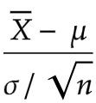
Hypothesis Testing: Step by Step
Step 3: Calculate Test Statistic
The test statistic used to assess the population mean depends on the specific type of test being conducted. In general, when checking for a population mean (μ), the common formula for the test statistic is
hypothesized population mean
sample mean
Std of the population
sample size
The test statistic quantifies how many standard deviations the sample mean is from the hypothesized population mean, aiding in the determination of whether to reject the null hypothesis based on the observed sample data.

Slide 17
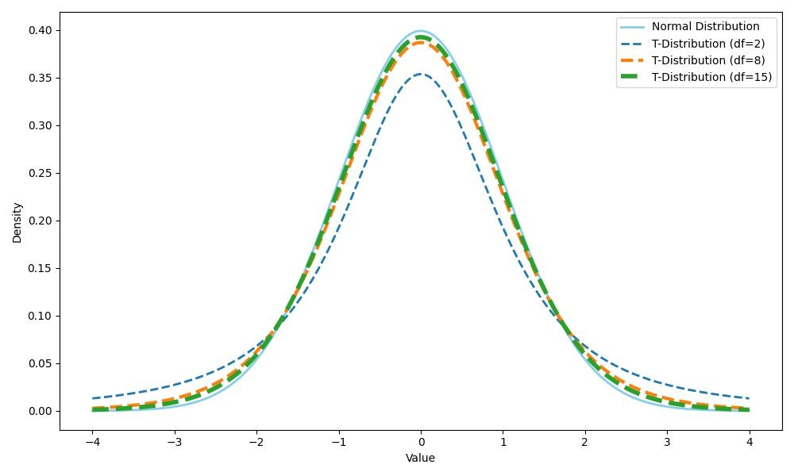

Hypothesis Testing: Step by Step
Step 3: Calculate Test Statistic
When 𝜎 is known, the appropriate test statistic is the z-score. This statistic conforms to a normal distribution.
When 𝜎 is unknown or the number of samples is
<30, the appropriate test statistic is the t-statistic. This statistic conforms to a t-distribution.

Slide 18
Hypothesis Testing
Step 4: Determine P-value
Having obtained a test statistic and considered the distribution of our samples (whether normal or T), we can now evaluate the probability of getting a sample mean as extreme as the one we observed. This probability is known as the p-value.
If the p-value is low, it means that the likelihood of obtaining the observed results, or more extreme results, under is unlikely. This often leads to rejecting the null hypothesis in favor of an alternative hypothesis.

Slide 19
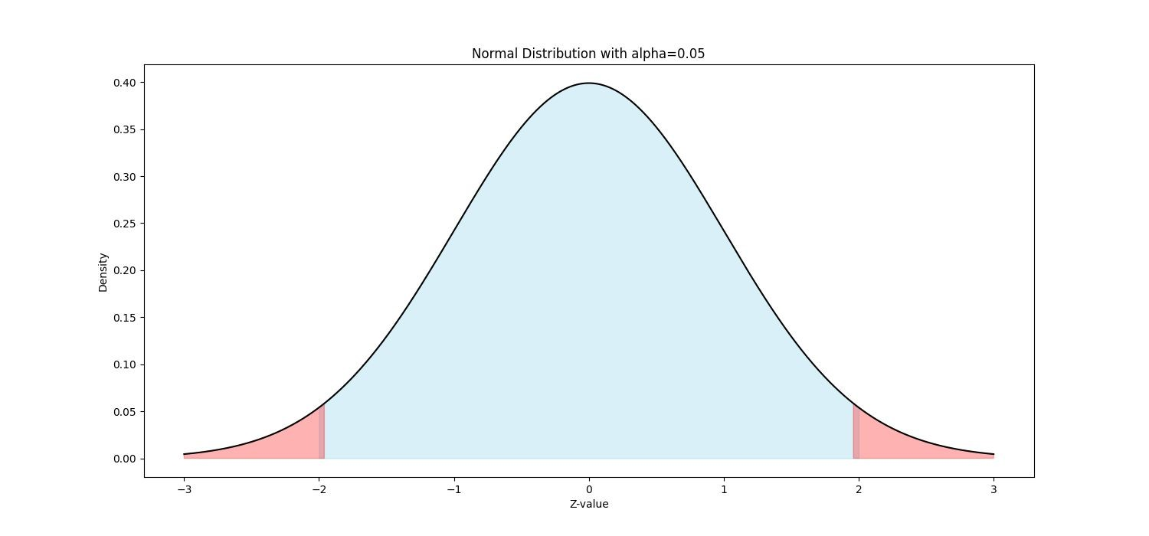

Hypothesis Testing
Step 5: Decision-making
Finally, we need to decide whether to reject
or fail to reject it.
In two-tailed tests (when we test for equalities):
If p_value < 𝛼 we reject the null hypothesis.
If p_value > 𝛼 we fail to reject the null hypothesis.
Reject the null

Slide 20
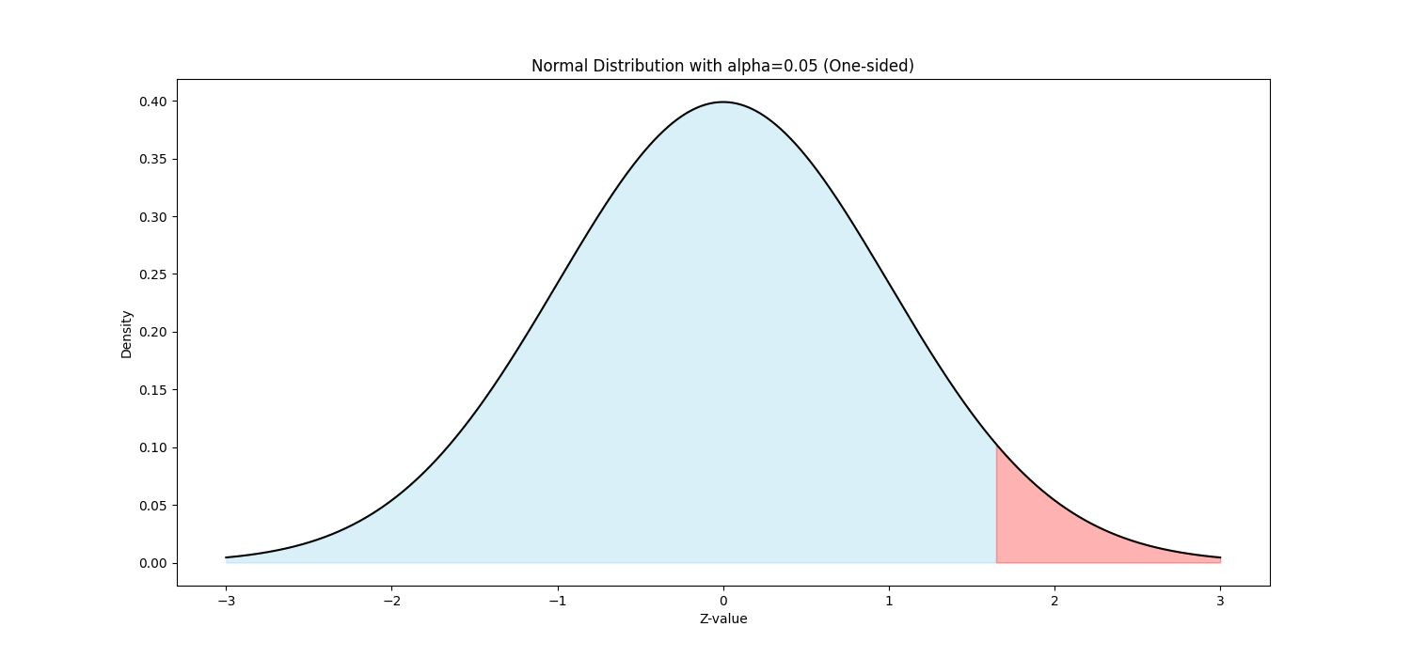
Hypothesis Testing
Step 5: Decision-making
In one-tailed tests (when we test for inequalities):
If p_value < 𝛼 and the test statistic is in the same direction as hypothesis.
If p_value > 𝛼 or the test statistic is in opposite direction as hypothesis.
we reject the null
we fail to reject the null
H₀: μ ≤ k H₁: μ > k
Reject the null

Slide 21



Hypothesis Testing
Different Types of Tests
One Sample T-test
○
in python: ttest_1samp(sample, k, alternative = “two-sided”)
○
in python: ttest_1samp(sample, k, alternative = “greater”)
○
in python: ttest_1samp(sample, k, alternative = “less”)

Slide 22
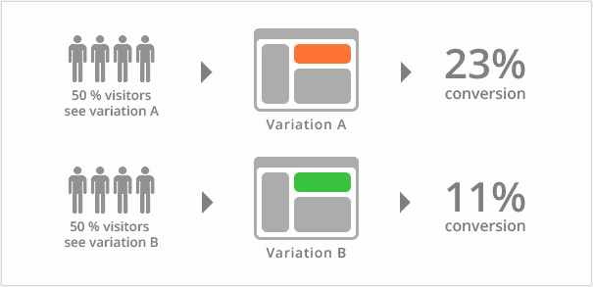



Hypothesis Testing
Different Types of Tests
Two Sample T-test (compares the means of two independent samples)
in python: ttest_ind(sample1, sample2, alternative = “two-sided”)
○
in python: ttest_ind(sample1, sample2, alternative = “greater”)
○
in python: ttest_ind(sample1, sample2, alternative = “less”)

Slide 23
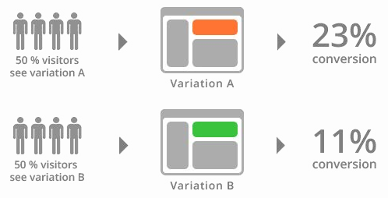
Hypothesis Testing
Different Types of Tests
Two Sample T-test (compares the means of two independent samples)

Slide 24
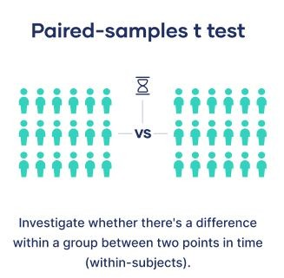
Hypothesis Testing
Different Types of Tests
Paired Sample T-test (compares the means of two dependent samples)
in python: ttest_rel(sample1, sample2, alternative = “two-sided”)
○
in python: ttest_rel(sample1, sample2, alternative = “greater”)
○
in python: ttest_rel(sample1, sample2, alternative = “less”)

Slide 25
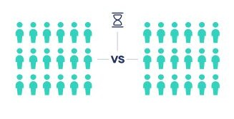
Hypothesis Testing
Different Types of Tests
Paired Sample T-test (compares the means of two dependent samples)
Investigate whether there’s a difference within a group between two points in time
(within-subjects)

Slide 26

Hypothesis Testing
Different Types of Tests
ANOVA (compares the means of multiple independent samples)
in python: f_oneway(sample_1, sample_2, sample_3, …, sample_n)

Slide 27
Summary
Lets build the summary?

